Slide 1

Pharmacy Management System
An Overview of Web Development in Pharmacy Management
Kapupara Krushil(12202080501030)
Preet Goyani(12202080501041)
Rajdeep Raval (12202080501046)

Slide 2

Introduction
A Pharmacy Management System (PMS) is a comprehensive solution designed to manage the entire workflow of a pharmacy. It helps in managing inventory, processing prescriptions, billing, and ensuring compliance with regulations.
Pharmacist (Admin) side website.

Slide 3


Definition
A Pharmacy Management System (PMS) is a software application that automates the pharmacy's operations, including inventory management, prescription processing, billing, and reporting. It aims to improve efficiency, accuracy, and customer service in the pharmacy.

Slide 4
Features of Pharmacy Management System
- Inventory Management
- Prescription Processing
- Billing and Invoicing
- Reporting and Analytics
- Compliance with Regulations
- Customer Management

Slide 5
Benefits of Pharmacy Management System
- Improved Efficiency
- Enhanced Accuracy
- Better Customer Service
- Streamlined Operations
- Regulatory Compliance
- Data-Driven Decision Making

Slide 6

Framework For website
To develop a website for a Pharmacy Management System, consider using the following frameworks:
- Frontend: HTML , CSS , JS
- Backend: PHP
- Database: MySQL .

Slide 7
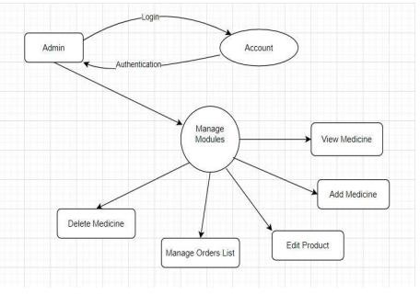
Flow Diagram

Slide 8
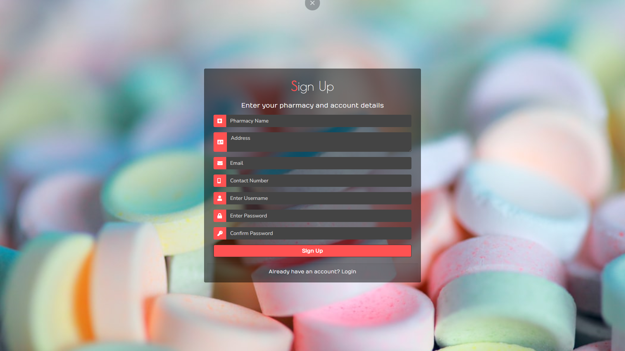

Slide 9
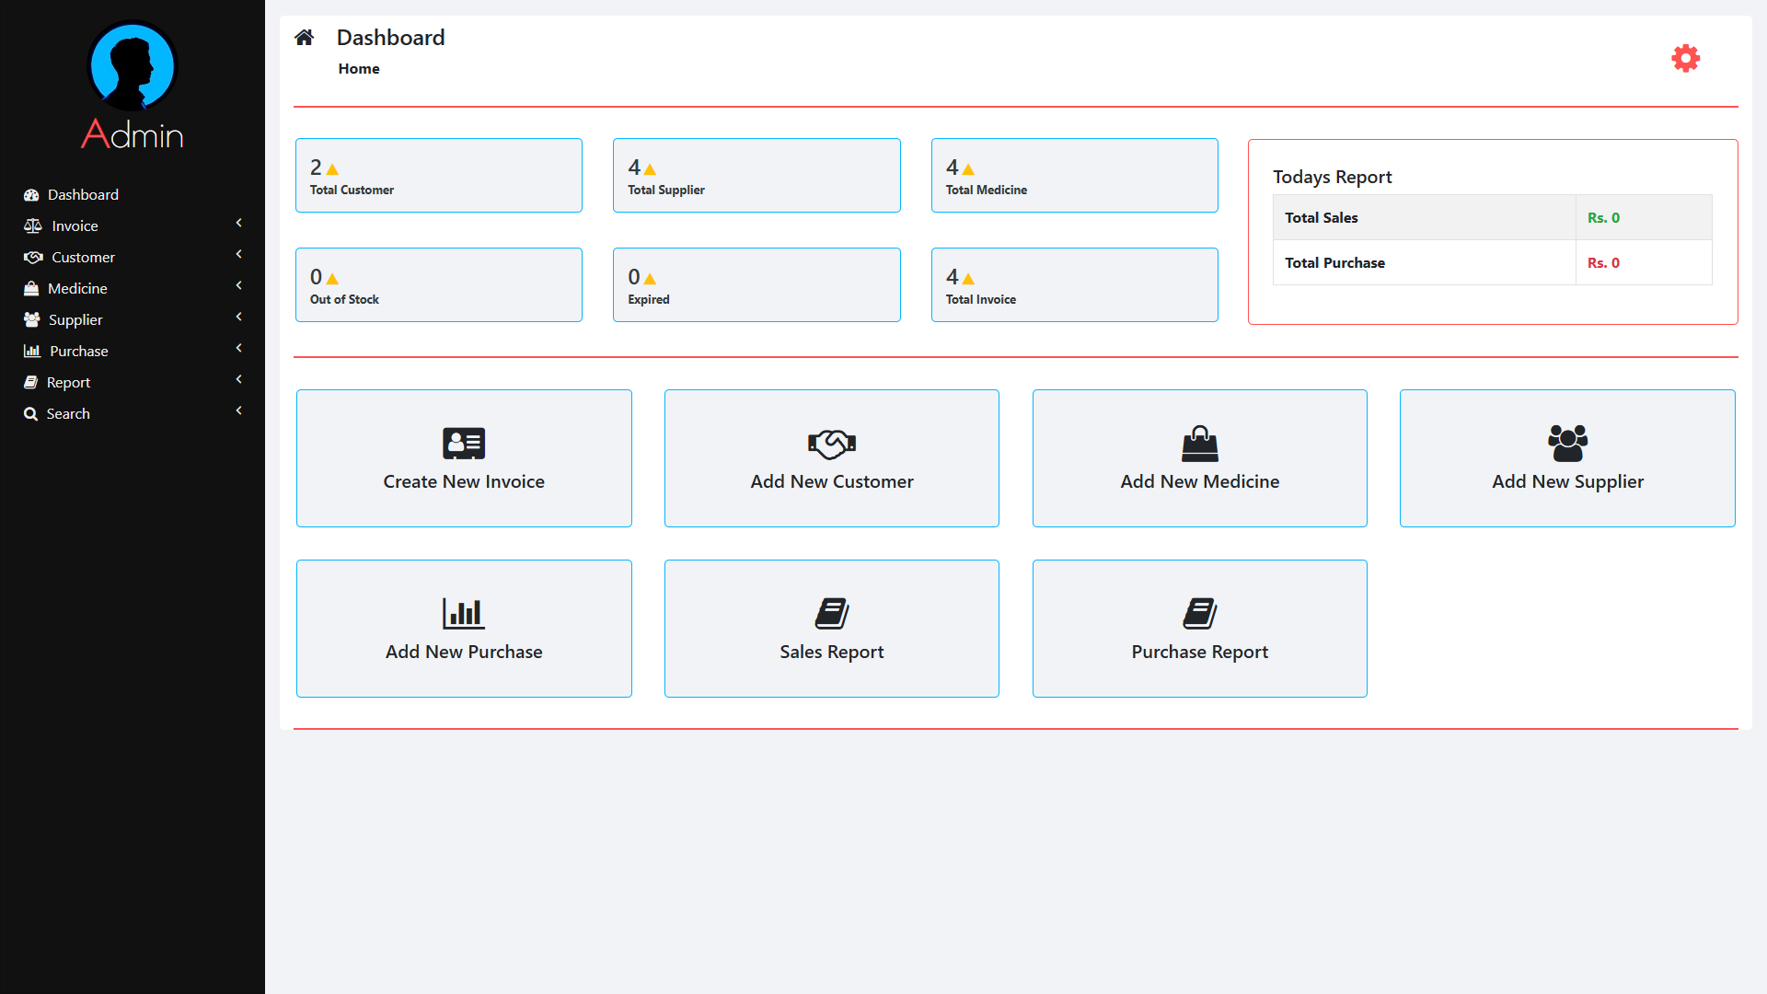

Slide 10
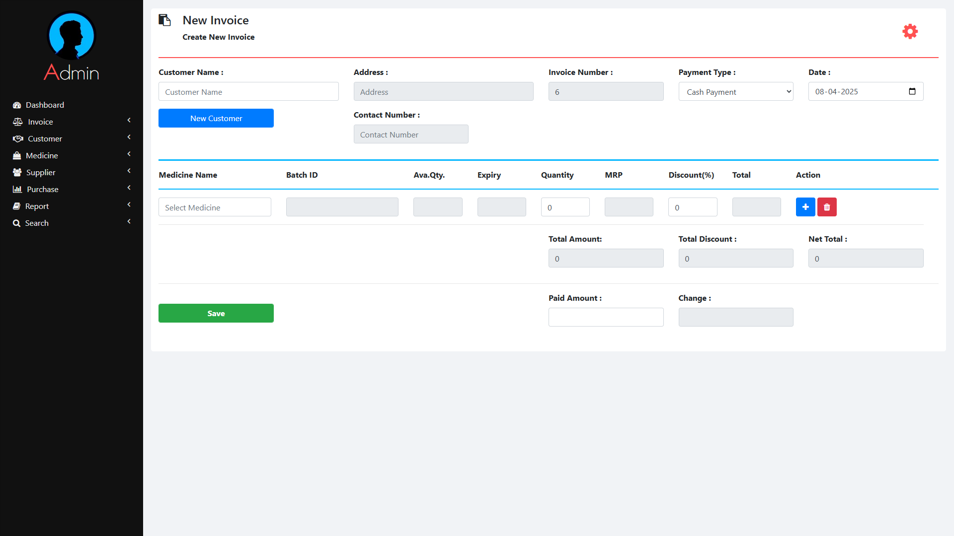

Slide 11
THANK YOU

